Slide 1

Metaphors
Students will be able to define a metaphor and write one of their own.
https://www.youtube.com/watch?v=jN104uji--Y

Slide 2
February 24, 2014 Metaphors
A metaphor compares two things by saying that one thing IS the other.
Does not use like or as.

Slide 3
Why use a metaphor?
It makes a vivid mental picture.
Is a stronger comparison than a simile.
The reader has to find similarities… like a detective finding clues.

Slide 4

An author uses metaphors to give the reader clues about the plot, characters, or setting.
The reader has to make connections between the two things in the metaphor.

Slide 5

After a long day of hiking, the kids were pigs at dinner.
?
What’s being compared? What clues help you understand the comparison?

Slide 6
The Cafeteria
The cafeteria is a jungle.
Wild animals scrambling for food. Grunting
like wild boars
Stampeding
to the line
Devouring
their prey
Cleaning
their paws
and then returning to their dens.
By: Alex Foster, Maura Grasshoff, Bridget Bradley, and Christa Michel

Slide 7
Honey
A busy bee’s a poem
With nectar that’s so fine
A reader-eater laps up
Every honey of a line.
By J. Patrick Lewis.
How are bees and poems alike in this poem?

Slide 8
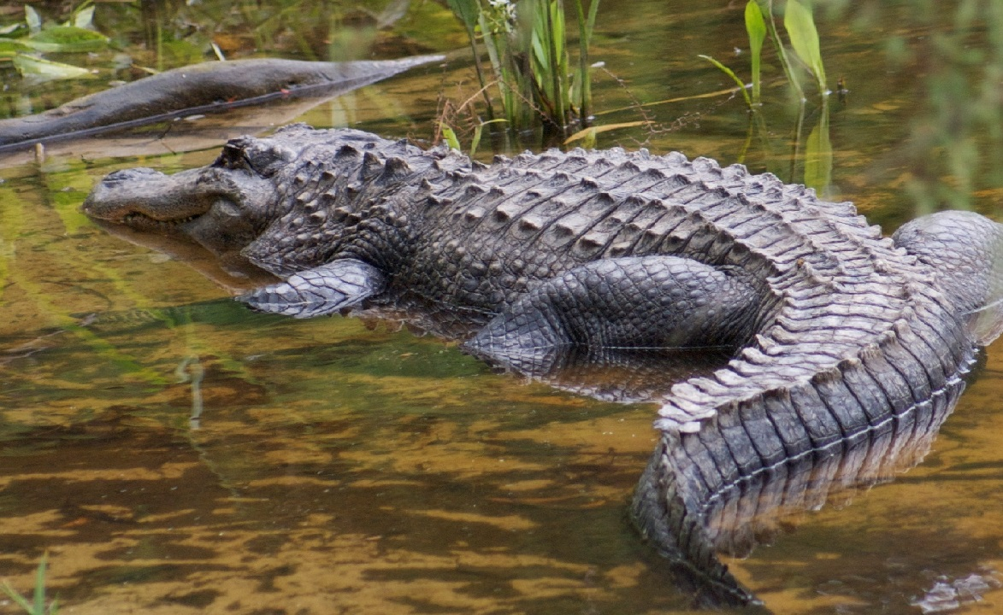
Crocodile
Upon
the watery
deeps
he lives,
and floats
the timbers of his ribs.
The cargo
of his belly
rides
heavy
in his iron hide.
________________________________________________________________________________________________________________________________________________________________________________________________________________________________________________________________________________________________

